Slide 1
EACA COST OF PITCHING SURVEY
Preliminary Findings (April 2025)

Slide 2
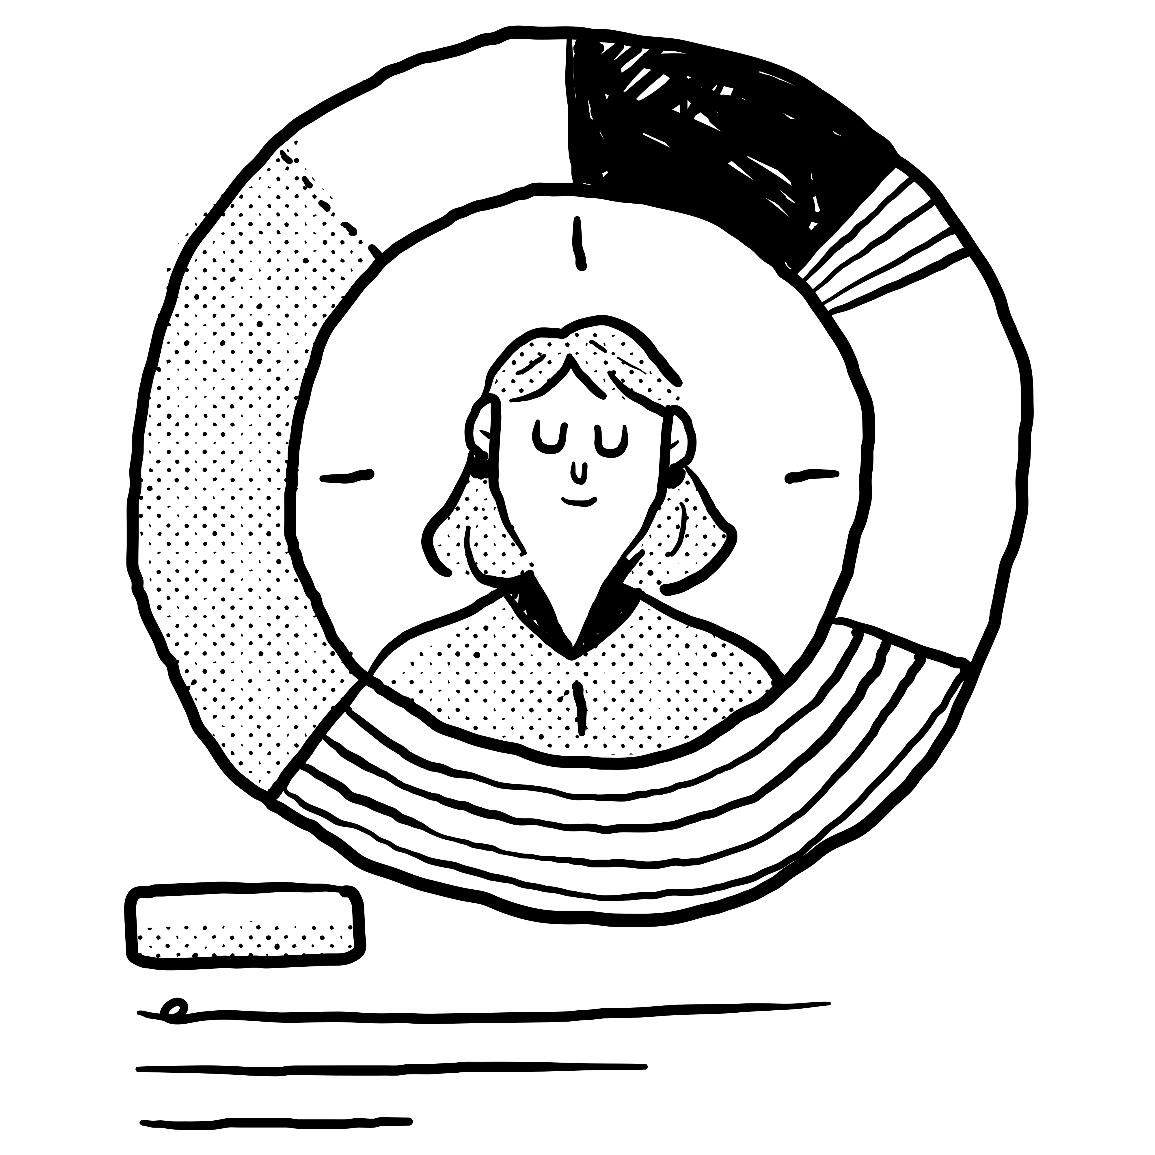
Cost of Pitching Survey:
Executive Summary
412 responses from 23 countries
Respondent profile:
  70% C-Level employees
  53% from Advertising/Full-Service agencies
Respondents took part in 2,895 pitches in 2024
  49% participated in both new business pitches & incumbent account reviews
  43% only pitched to solicit new business
  8% only pitched in response to an incumbent review
External consultants brought in on 59% of new business pitches and 22% of incumbent review pitches – contributing on average €4,700

Slide 3
The Average Pitch
On average, agencies participated in 4 pitches in response to an account review and 14 to solicit new business.
Average costs involved:
 | Incumbent account review | New business pitch
Total cost | €28,355 | €43,804
People involved | 5 people | 8 people
Hours per person | 43.8 hrs | 47.7 hrs
Cost per person | €3,732 | €4,465
Intermediaries | €3,421 | €3,288
Out-of-pocket expenses | €5,879 | €9,109
Ideas, strategy, creative assets | €11,686 | €17,843

Slide 4
The Average Pitch
Pitching most costly for media buying and planning agencies
Social media advertising agencies report the lowest cost of pitching
Report by AACC shows that the price of pitching increased by 78% between 2021 and 2023

Slide 5
Cost of Pitching Survey:
Preliminary Findings
Most important pitch process elements – clear briefing, involvement of decision makers, feedback
  Feedback and clear briefing least likely to be part of the pitch process
AI mostly used as a support tool – to reduce costs, increase efficiency and productivity; usage expected to increase in next 2 years
  Some respondents face pressure from clients in understanding if agencies are on top of AI and a general need to have an explainable AI approach
  68% of pitches asked for creative proposals – only 42% of those were executed
  Agencies asked for sustainability policies 27% of the time

Slide 6

Cost of Pitching Survey:
Preliminary Findings
Main areas of concern in the industry:
  Financial pressures, incl. unpaid work
  AI & technological disruption
  Talent shortage
  Ethics and transparency
  Market & economic uncertainty
  Decline in creative standards and industry value

